Slide 1
Love the life you live, Live the life you love
The importance of every single person is our treasure. Cause we are all sons of God and we're equal. Nowdays many teenagers, and others, are victim of bullism and it's a bad thing that the society doesn't help.

Slide 2
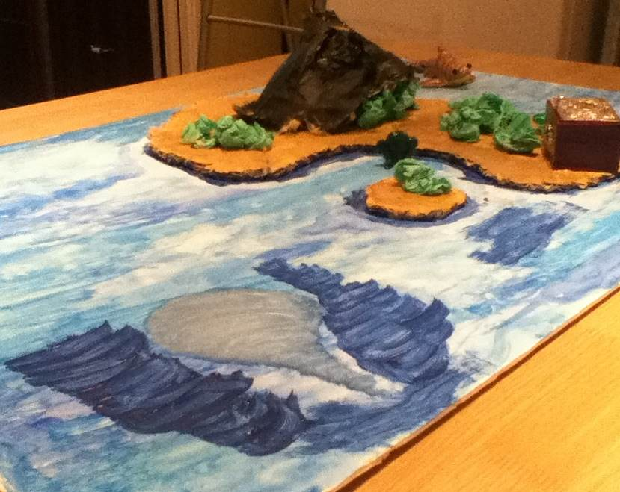
THIS MODEL REPRESENTS
THE TRASURE OF OUR LIFE.

Slide 3
FEAR
The shark is the fear to be yourself or listen to the music that you like. So you wear this kind of mask that hides the true YOU.

Slide 4
SHYNESS
The vortice is the shyness that sucks you and doesn't make you socialize with other people

Slide 5
BULLY
The monster is the tipic bully that makes you feel more insicure than you were at the beginning.

Slide 6
FEELING ALONE
The trees (generally the forest) is the social network that stucks you at home when you where suppose to go outside and make "true" friends around you.

Slide 7
THE SEA
The sea is the society that isolates you and makes you feel alone.

Slide 8
Finally you have to keep this in your mind: love the life you live and live the life you love...

